Slide 1
TSE6 - OpenCL
Part 1
Introduction

Slide 2
Class introduction
Week planning (subject to change)
All assignments, except the first, must be marked sufficiently
In the final project, you solve a problem of your own choice
“It’s working” is not enough; some degree of optimization is required
Week | Theory | Practical
1 | Weird week
2 | Introduction OpenCL | Assignment 1 (not graded)
3 | Memory types OpenCL | Assignment 2
4 | Synchronization | Assignment 3
5 | OpenCL and OpenGL | Assignment 4
6 | Memory Optimization | Assignment 5; proposal for final project
7 | Easter Monday
8 |  | Work on final project
9 | Final project must be handed in on Wednesday; will be graded within a week
10 | If not sufficient, repairs can be done in this week

Slide 3
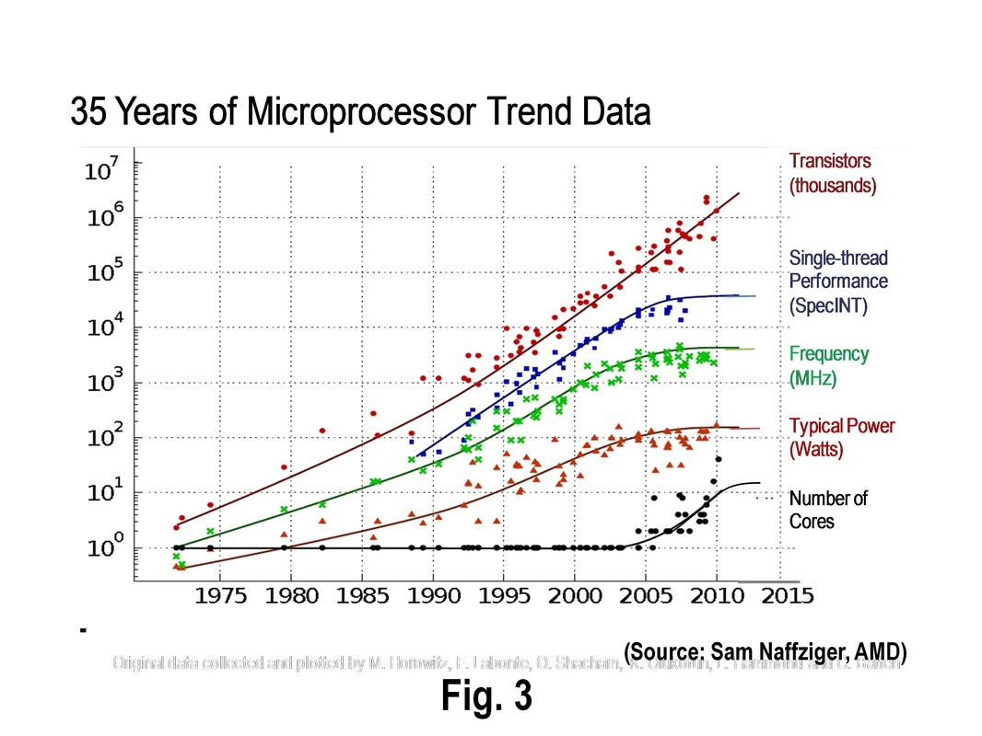
Evolution of processors

Slide 4

Why GPU’s?
Graphical Processing Unit
Primarily designed to do calculations in the field of 3D CGI, like:
Transformations
Filtering
Texture operations
Typically matrix operations, and locally concentrated operations → SIMD
GPU highly optimized for these operations, much faster than CPU
GPU can do other types of calculations → GPGPU (General Purpose GPU)
Usually programmed in C(++)-like way, using:
OpenCL (ATI and nvidia)
CUDA (nvidia)

Slide 5
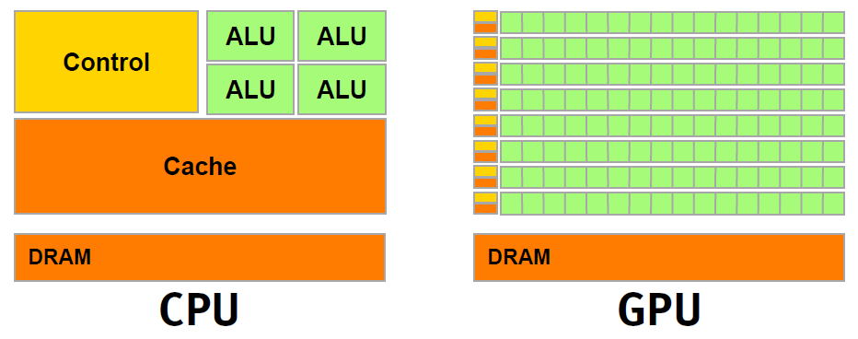
Why GPU’s?
More % of silicon dedicated to computations (green)
Less is needed for control&cache (yellow/orange)

Slide 6
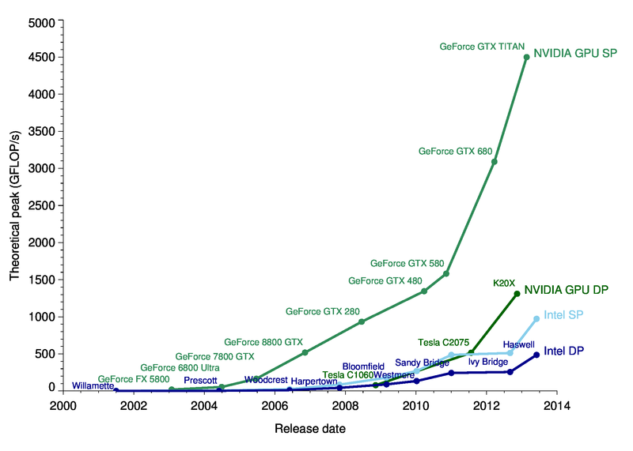
GPU/CPU performance comparison

Slide 7

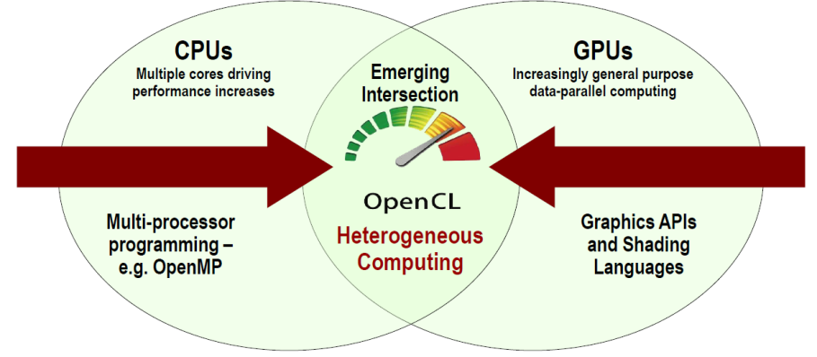
Introduction into OpenCL
OpenCL is a programming framework for heterogeneous computing resources
Suitable for CPUs, GPUs, Cell Broadband Engine, FPGAs, DSPs
It’s a standard, with several implementations from all major companies (AMD, Intel, nvidia, …)
Many introductions available; just two of them:
A gentle intoduction to OpenCL
OpenCL programming book
Competing framework is CUDA
Specifically for nvidia GPU’s
Made and maintained only by nvidia
Less general, but can be more efficient

Slide 8
Design goals of OpenCL
Use all computational resources in system
GPU’s and CPU’s as peers
Data- and task-parallel compute model
Efficient parallel programming model
Based on C
Abstracts the specifics of underlying hardware
Specify accuracy of floating point computations
IEEE754 compliant rounding behavior
Define maximum allowable error of math functions
Drive future hardware requirements

Slide 9

OpenCL versions
Initially developed by Apple, now maintained by Khronos group
First approved for public release in Nov 2008
Currently at version 2.1 (Nov 2015)

Slide 10
OpenCL Hardware Model
OpenCL can run on diverse range of hardware, but the general model is always the same
There is one Host, and any number of Compute Devices (CD)
A Compute Device is usually your graphics card, but can be any CPU, GPU, FPGA, etc
Each Compute Device is composed of one or more Compute Units (CU)
Each Compute Unit is further divided into one or more Processing Elements (PE)
Each PE is like a small processor (core)
Each PE can do FP instructions, etc
All PE’s in one CU execute the same instructions in SIMD/SPMD fashion

Slide 11
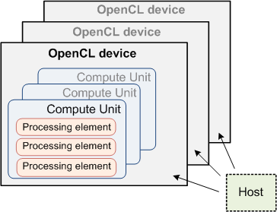
OpenCL Hardware Model

Slide 12
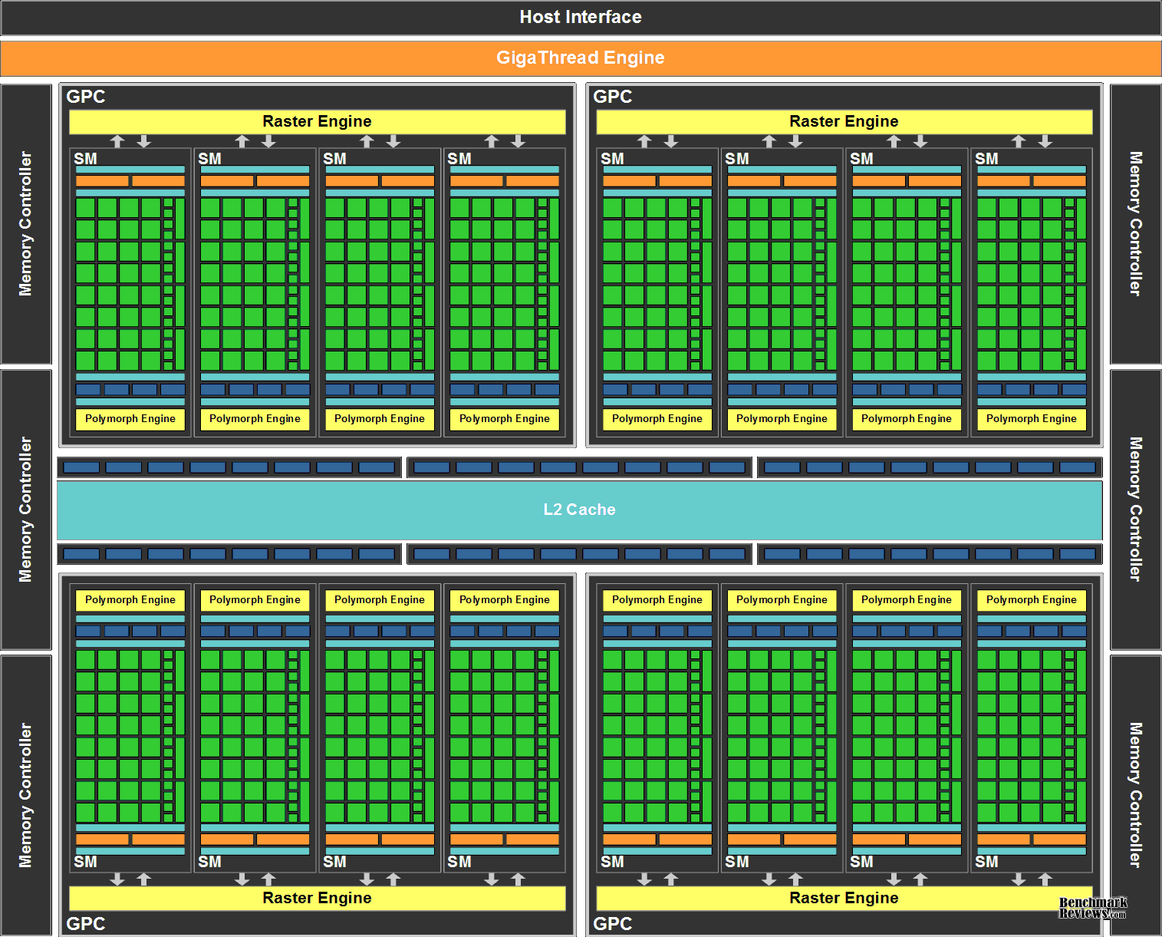
Example Compute Device: nvidia Fermi GPU
This is one CD
Contains 16 CU’s (=SM=Streaming Multiprocessor)
32 PE’s (=cores) per CU
→ 512 cores total
Latest nvidia GPU (Maxwell) has 2048 cores

Slide 13



OpenCL Software Execution Model
An OpenCL application runs on the host and submits work to the compute devices
Kernel: The code which is executed on a PE; basically a C function
Work item: One instance of the kernel, running on a PE
Work group: Group of work items running on one CU
Program: Collection of kernels and other functions
Context: The environment within which work-items executes
includes devices and their memories and command queues
Device Queue: kernel calls are queued in-order
one queue per device
executed in-order or out-of-order
GPU device
CPU
Context
Queue
Queue

Slide 14
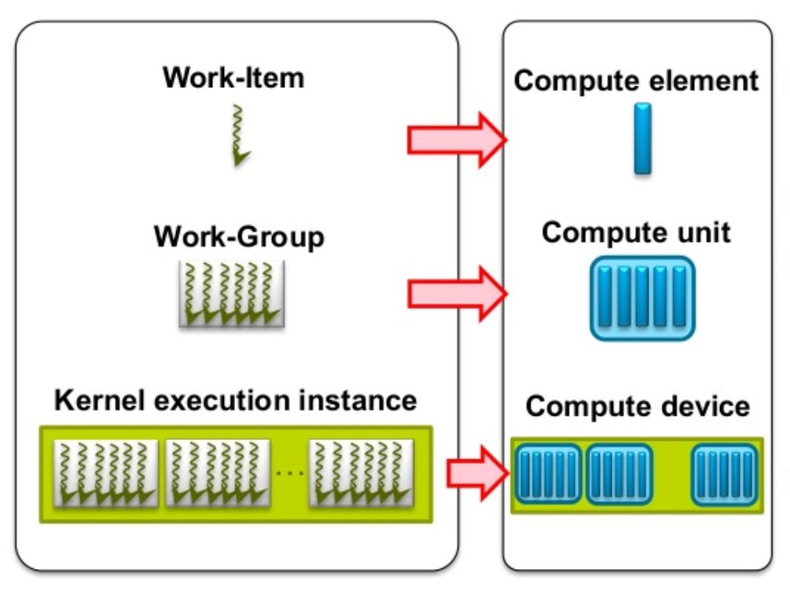
SW → HW mapping
Each Work Item is executed on a Processing Element (Compute Element)
Each Work Group is executed on a Compute Unit
Several Work Groups can run on one Compute Unit
Kernel is running on a Compute Device

Slide 15
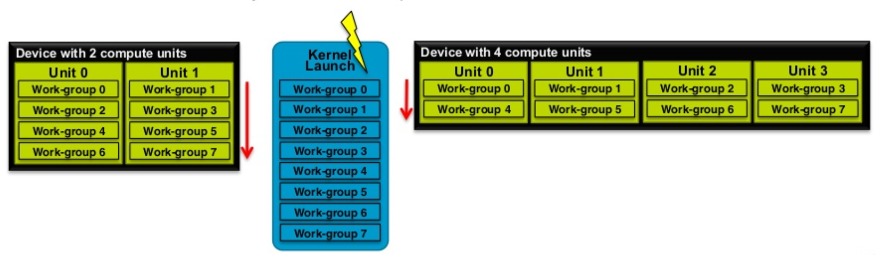
Work Groups
Work Groups can execute in any order, concurrently or sequentially
Fast shared memory and synchronization
Scales across any number of Compute Units

Slide 16
Writing a kernel
Kernels are written in OpenCL C, a special language, based on C99 with some extensions and limitations
Extra datatypes
Extra keywords
No recursion
and some more differences, see OpenCL C 2.0 specification
The kernel is an OpenCL C function that
has to start with __kernel
can have arguments
can call other functions from the kernel

Slide 17
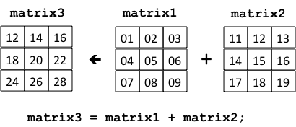
Kernel structure
We don’t have 2D arrays in OpenCL, so we mimic it with a 1D array
Example: matrix addition:
Each PE does one single addition
9 PE’s run in parallel
All PE’s execute exactly the same code (kernel)
How does a PE know which addition it has to do (what are the indices i and j)?
__kernel void addArray
(__global float* A,
__global float* B,
__global float* C
)
{
int w = ..., h = ...; int i = ..., j = ...;
C[i*w+j] = A[i*w+j] + B[i*w+j];
}

Slide 18
Kernel dimensions
When starting a kernel, we specify
how often it must be repeated (how many work items from this kernel)
global work size
how many of them have to run on the same CU (how many work items in a work group)
workgroup size (aka ‘local work size’)
A kernel can be started in 1D (sequence), 2D (matrix) or 3D (cube)

Slide 19
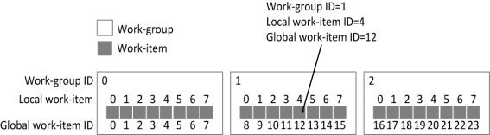
Kernel dimensions
1-dimensional sequence of work items
Example: 24 work items, divided in groups of 8
(global id) = (workgroup id)*(workgroup size)+(local id)
Each work item can query its own position
global id → get_global_id(0)
workgroup id → get_group_id(0)
local id → get_local_id(0)
workgroup size → get_group_size(0)
and a few more like these, see Work Item Built-In Functions

Slide 20
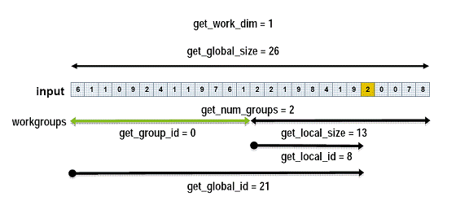
Kernel dimensions
Another 1-dimensional example

Slide 21
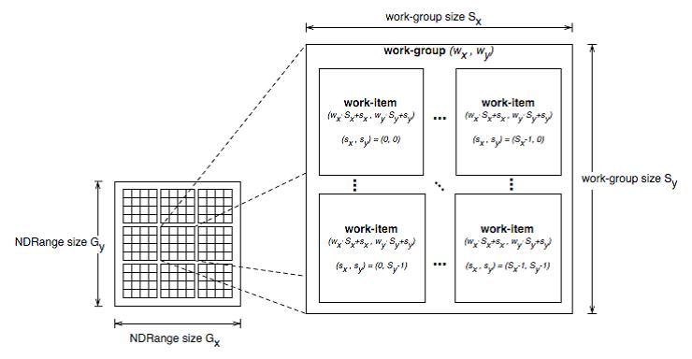
Kernel dimensions
2-dimensional matrix of work items
S_{x} = get_local_size(0)
S_{y} = get_local_size(1)
G_{x} = get_global_size(0)
G_{y} = get_global_size(1)
w_{x} = get_group_id(0)
w_{y} = get_group_id(1)
s_{x} = get_local_id(0)
s_{y} = get_local_id(1)

Slide 22
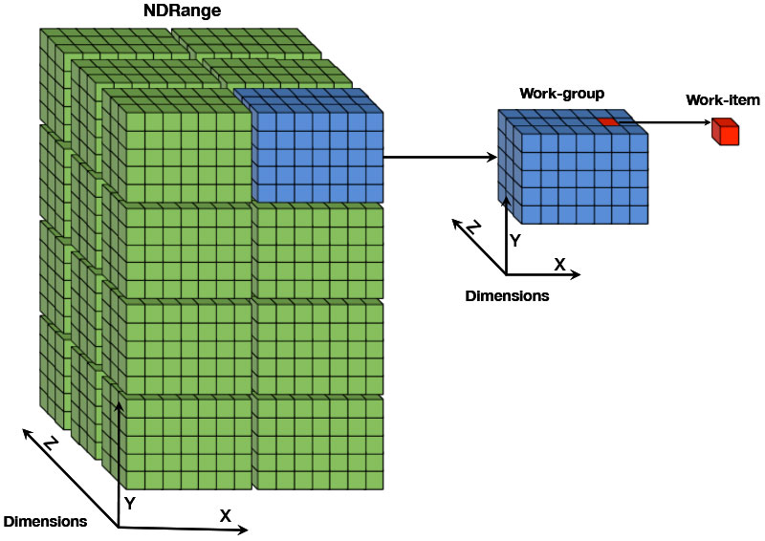
Kernel dimensions
3-dimensional cube of work items
Similar to 1D and 2D

Slide 23
How to start a kernel
We can start a kernel with clEnqueueNDRangeKernel(...)
Specify the dimension/sizes, and the queue in which to place the kernel
See specs
Example
clEnqueueNDRangeKernel (queue, // queue in which to place this kernel kernel, // the kernel itself 1, // number of dimensions (1, 2 or 3) NULL, // ignore for now globalSize, // array with global sizes in each dim localSize, // array with workgroup sizes in each dim 0, // ignore for now NULL, // ignore for now NULL // ignore for now );

Slide 24
Back to the matrix addition example
It’s a 3x3 matrix, so if we choose workgroupsize 1x1, then we would have to start that with:
size_t globalsize[]={3,3}, localsize[]={1,1}; clEnqueueNDRangeKernel (queue, kernel, 2, // it’s a 2-dimensional matrix NULL, globalSize, // 3x3 work items globally localSize, // 1x1 work item per group 0, NULL, NULL );
localSize might be NULL, then OpenCL will choose

Slide 25
How to configure the kernel
We have to make a number of choices for the kernel:
How many dimensions
1D, 2D or 3D
Global size per dimension
Example: if we have 16 work items, then 1x16, 2x8, or 4x4
Size of the workgroups
Example: if global dimensions are 4x4, workgroup size could be 1x1, 2x2, 4x4, 1x4, 2x4, etc but also 3x3 would be possible
First 2 settings usually follow logically from the problem itself
Example: if we have to do an operation on a 1000x10 matrix, then we define the kernel to be 2D with a global size of 1000x10
Workgroup size is more critical

Slide 26
Considerations for workgroup size
One consideration depends on the GPU architecture
All work items in a work group run on the same CU
Work group too big (eg same as global dimensions)
→ then there is only 1 work group, so only 1 CU will be used
Work group should not be smaller than size of the CU,
→ otherwise some PE’s will be idle
GPU properties can be queried with clGetDeviceInfo
Some other considerations depend on the chosen algorithm:
Only work items in the same work group can share (very fast) local memory (see week 2)
Only work items in the same work group can be synchronized (see week 3)

Slide 27
Complete OpenCL program
Most basic concepts are described above
Unfortunately, a lot of extra code is needed to
allocate memory on the Compute Device
setup a context, kernel, kernel arguments, device queue, etc
compile the kernel to machine code
copy information from host memory to device memory and back

Slide 28
/* Declare (and initialize) all the necessary variables */
......
/* Create OpenCL Context */
context = clCreateContext(NULL, 1, &device_id, NULL, NULL, &ret);
/* Create command queue */
command_queue = clCreateCommandQueue(context, device_id, 0, &ret);
/* Allocate memory for arrays on the Compute Device */
AonDevice = clCreateBuffer(context, CL_MEM_READ_WRITE, 3*3*sizeof(int), NULL, &ret);
BonDevice = clCreateBuffer(context, CL_MEM_READ_WRITE, 3*3*sizeof(int), NULL, &ret);
ConDevice = clCreateBuffer(context, CL_MEM_READ_WRITE, 3*3*sizeof(int), NULL, &ret);
/* Copy arrays A and B from host memory to Compute Devive */
ret = clEnqueueWriteBuffer(command_queue, AonDevice, CL_TRUE, 0, 3*3*sizeof(int), A, 0, NULL, NULL);
ret = clEnqueueWriteBuffer(command_queue, BonDevice, CL_TRUE, 0, 3*3*sizeof(int), B, 0, NULL, NULL);
/* Create kernel program */
program = clCreateProgramWithSource(context, 1, (const char **)&source_str, (const size_t *)&source_size, &ret);
/* Compile the program Just In Time to GPU machine code */
ret = clBuildProgram(program, 1, &device_id, NULL, NULL, NULL);
/* Create OpenCL kernel from the compiled program */
kernel = clCreateKernel(program, “addArray", &ret);
/* Set OpenCL kernel arguments */
ret = clSetKernelArg(kernel, 0, sizeof(cl_mem), (void *)&AonDevice);
ret = clSetKernelArg(kernel, 1, sizeof(cl_mem), (void *)&BonDevice);
ret = clSetKernelArg(kernel, 2, sizeof(cl_mem), (void *)&ConDevice);
/* Activate OpenCL kernel on the Compute Device; see previous slide */
......
/* Transfer result array C back to host */
ret = clEnqueueReadBuffer(command_queue, ConDevice, CL_TRUE, 0, 3*3*sizeof(int), C, 0, NULL, NULL);
The size of a matrix in bytes
This string contains the source code of the kernel program (see previous slide)
This source code string can be hard-coded, or read from a file

Slide 29
Kernel compilation
Every OpenCL implementation provides a compiler from OpenCL C to supported device executable code
The compiler supports standard set of OpenCL defined options
The kernels can be compiled either online (JIT, run‐time) or offline (build‐time)
For online compilation, OpenCL C source text is provided to host program → clBuildProgram
With offline compilation, executable device code is provided to host program
Run time compilation is more flexible for the final application, but may be problematic in some cases
Compilation errors need to be extracted from clBuildProgram
The kernel source code must be included in the application binaries

